Slide 1
Faults and Folds

Slide 2
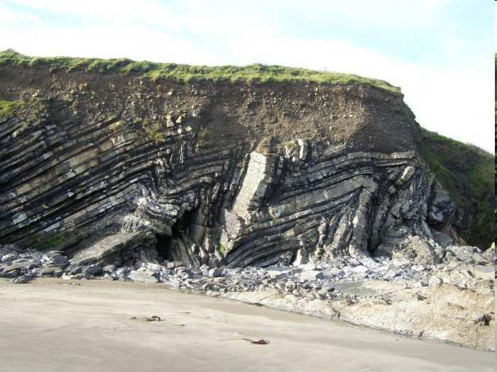
New Area of Focus: Faults and Folds.
Copyright © 2010 Ryan P. Murphy

Slide 3
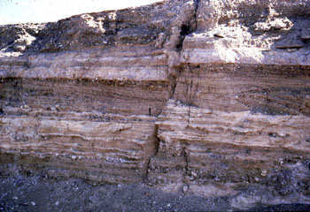
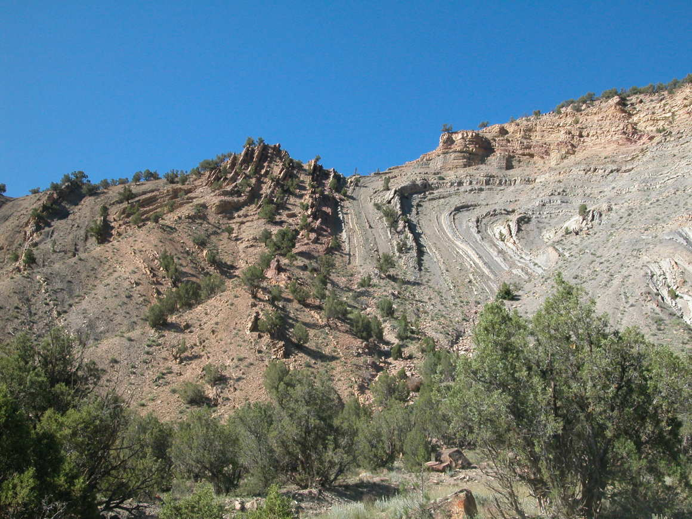
Movement of tectonic plates against each other cause the plates to fault and fold.
Copyright © 2010 Ryan P. Murphy

Slide 4
Movement of tectonic plates against each other cause the plates to fault and fold.
Copyright © 2010 Ryan P. Murphy

Slide 5
Movement of tectonic plates against each other cause the plates to fault and fold.
Fault
Copyright © 2010 Ryan P. Murphy

Slide 6
Movement of tectonic plates against each other cause the plates to fault and fold.
Fault
Copyright © 2010 Ryan P. Murphy

Slide 7
Movement of tectonic plates against each other cause the plates to fault and fold.
Fault
Copyright © 2010 Ryan P. Murphy

Slide 8
Movement of tectonic plates against each other cause the plates to fault and fold.
Fault
Fold
Copyright © 2010 Ryan P. Murphy

Slide 9
Movement of tectonic plates against each other cause the plates to fault and fold.
Fault
Fold
Copyright © 2010 Ryan P. Murphy

Slide 10
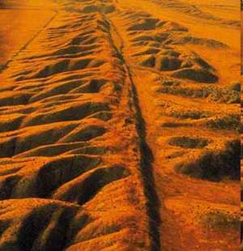
Fault: Break / crack where movement occurs.
Copyright © 2010 Ryan P. Murphy

Slide 11
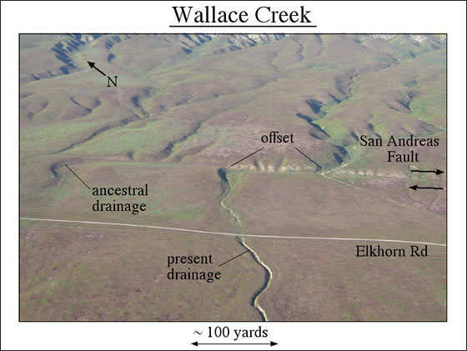

Slide 13
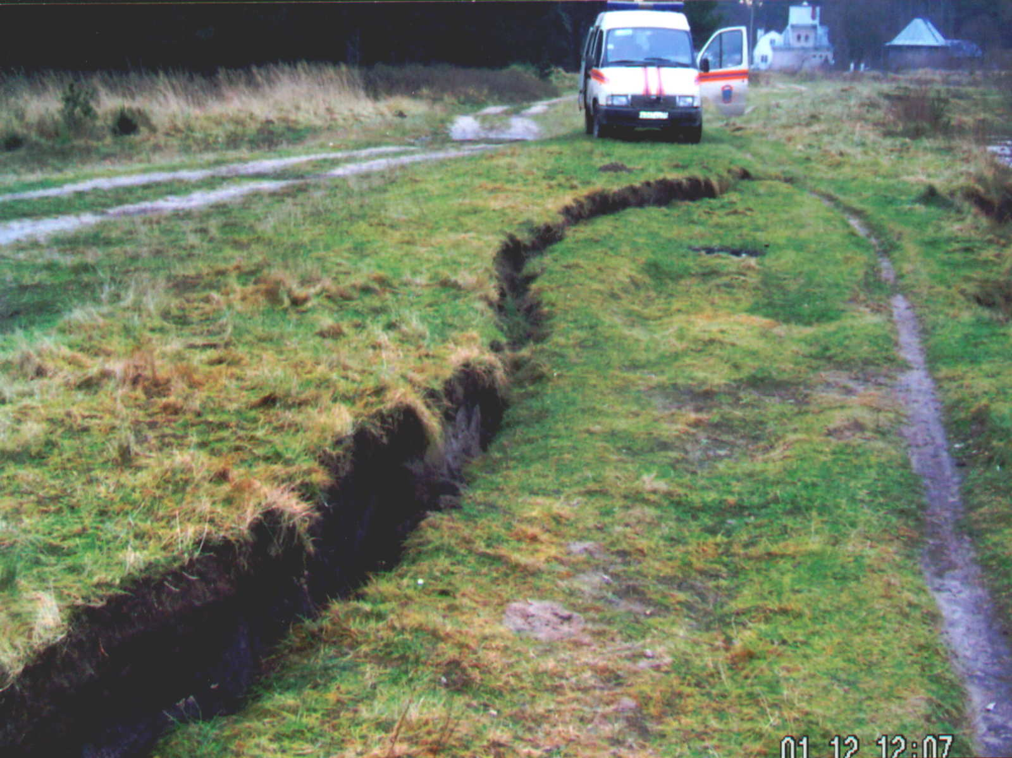

Slide 14
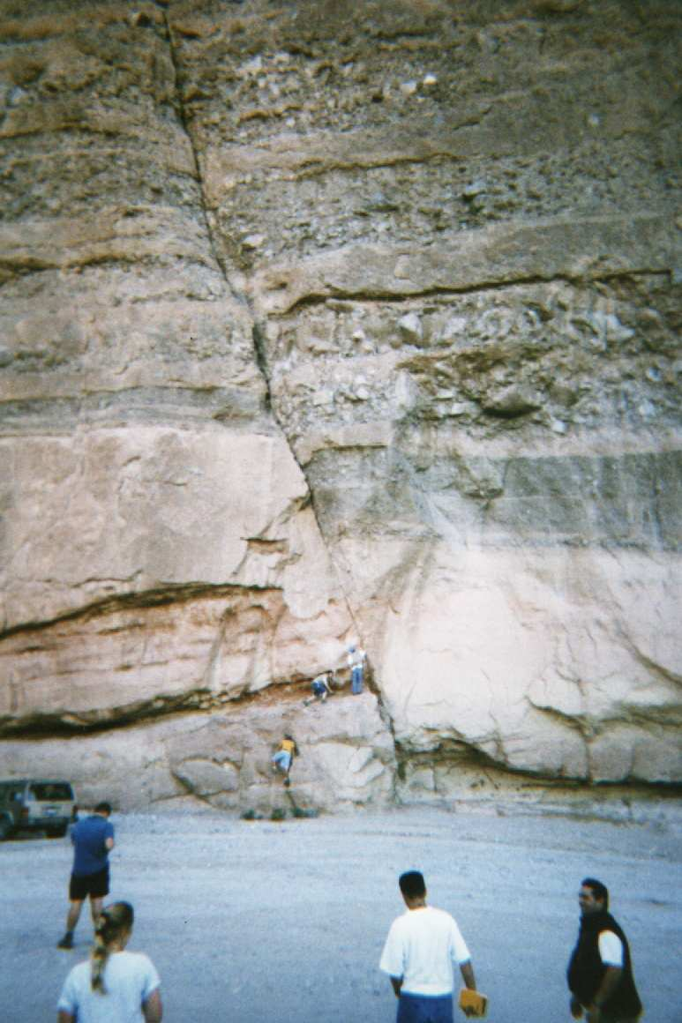

Slide 15
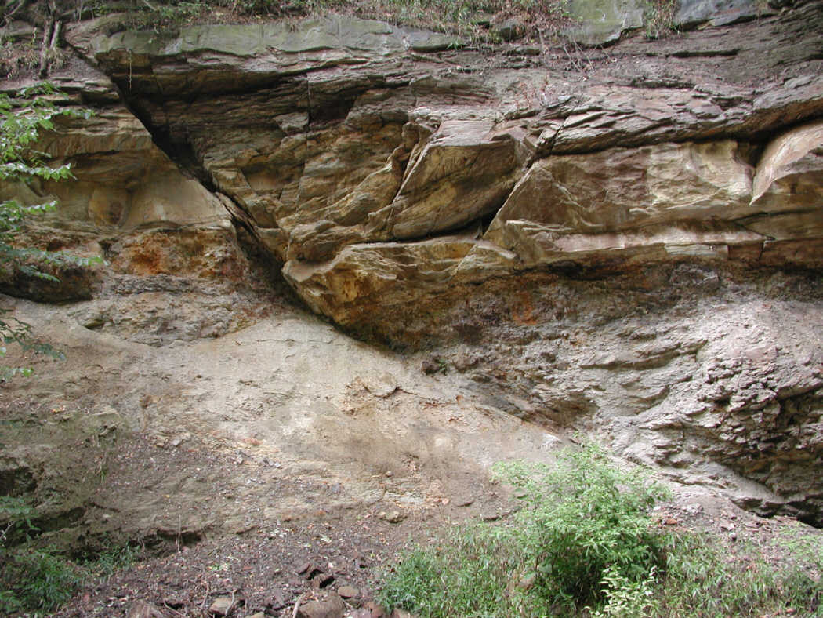

Slide 16
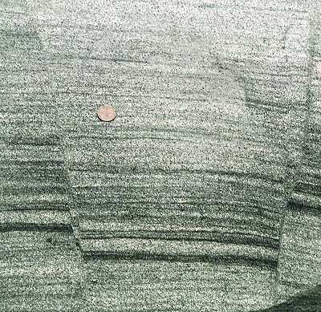
How large is this Fault?

Slide 17
How large is this Fault?

Slide 18
How large is this Fault?
Small!

Slide 19
How large is this Fault?
Small!
Geologist provide a size reference when they photograph.

Slide 20
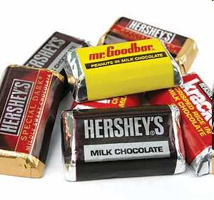
Activity! Learning about a fault.
Each student should be given one Hershey’s Miniatures. (Mr. Goodbar has peanuts ☹).
Draw a before picture.
Place thumbs under middle and bend Hershey’s Slowly until it snaps in wrapper.
Unwrap. Draw an after picture and label the fault. Do not eat yet!
Copyright © 2010 Ryan P. Murphy

Slide 21
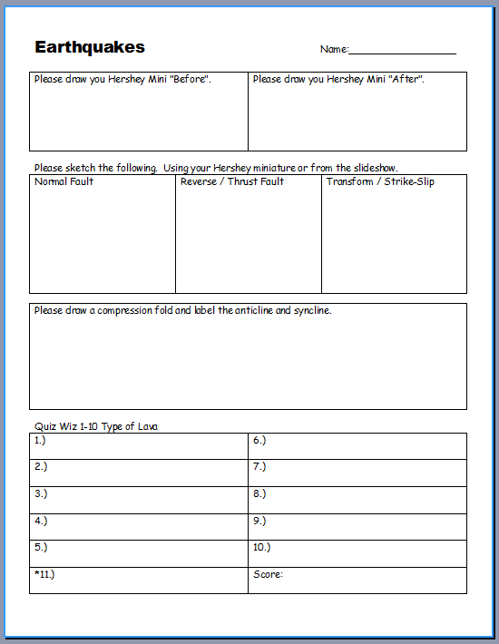

Slide 22
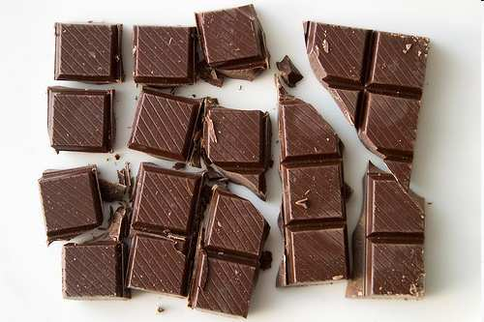
The Hershey’s Miniature should have snapped creating a break or fault in the chocolate.
Copyright © 2010 Ryan P. Murphy

Slide 24
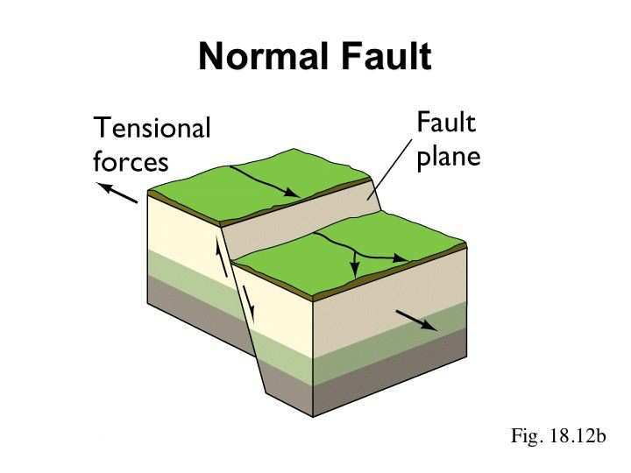
Normal Fault: Pulling apart tension causes crust to drop down.
Copyright © 2010 Ryan P. Murphy

Slide 25
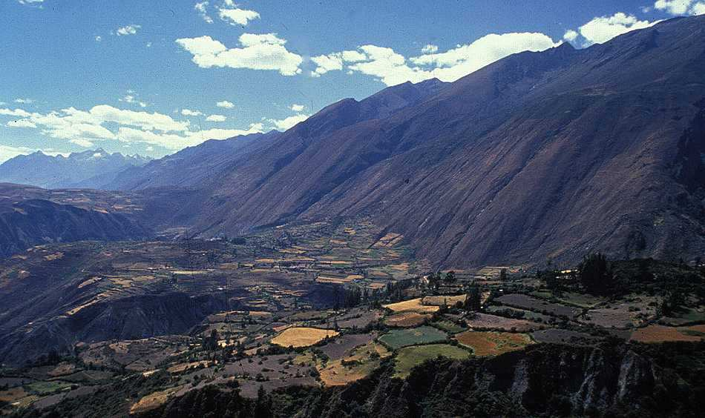

Slide 26
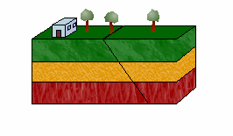

Slide 28
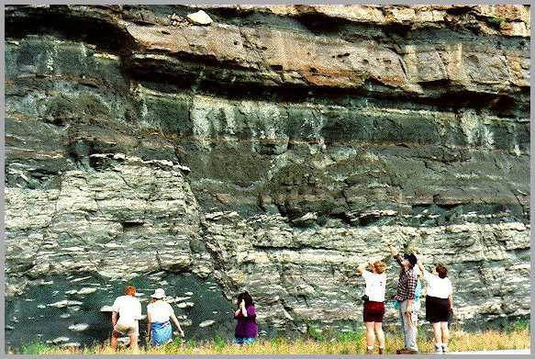

Slide 29
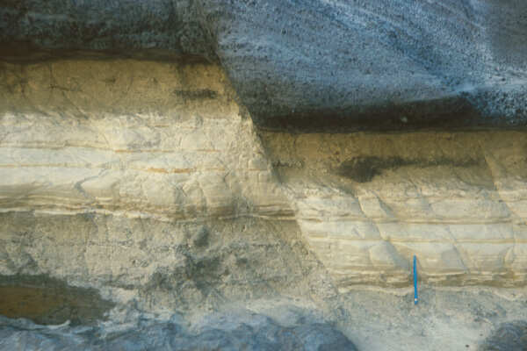

Slide 36
Activity! Demonstrate a normal fault using some classroom materials.
Ideas
Clay
Styrofoam
Foam pads
Index Cards
Card Board

Slide 38
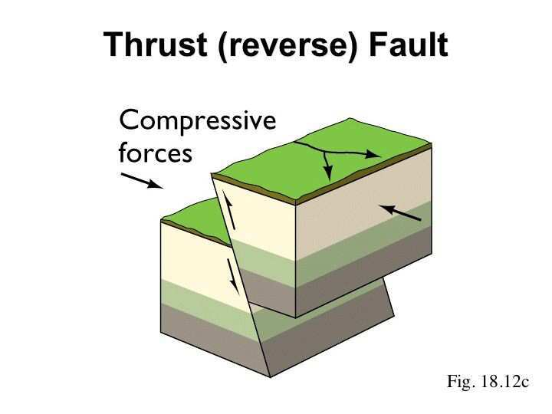
Thrust / Reverse Fault: Compression forces cause crust to move up.
Copyright © 2010 Ryan P. Murphy

Slide 39
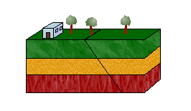

Slide 40
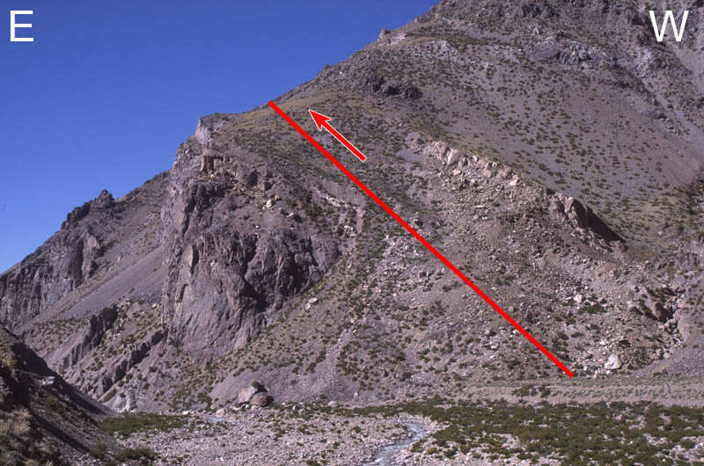

Slide 43
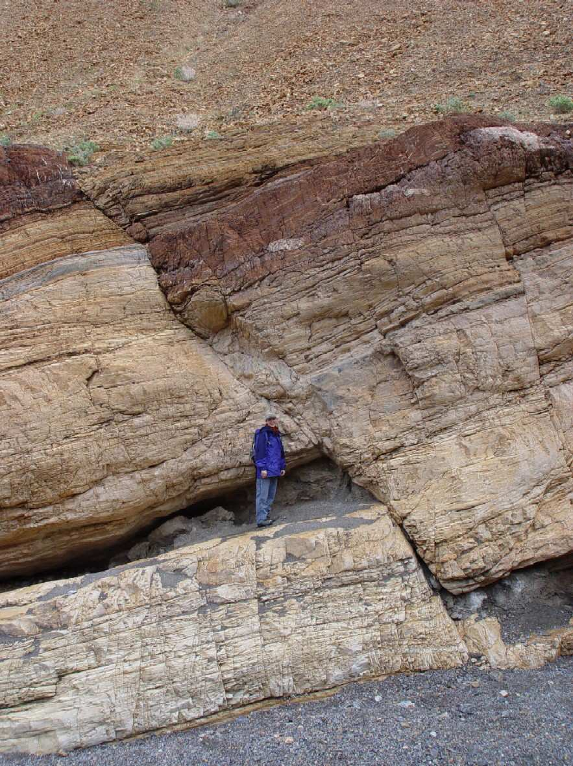

Slide 44
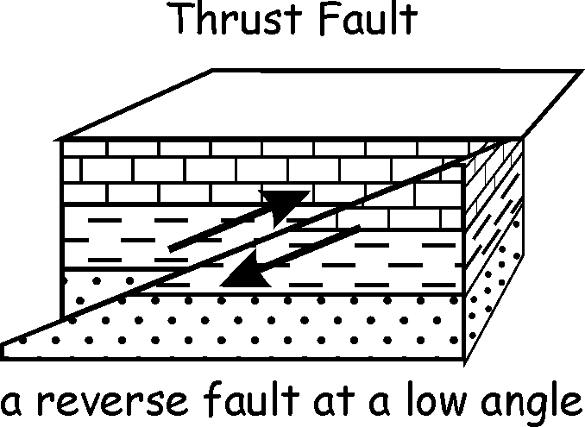

Slide 45
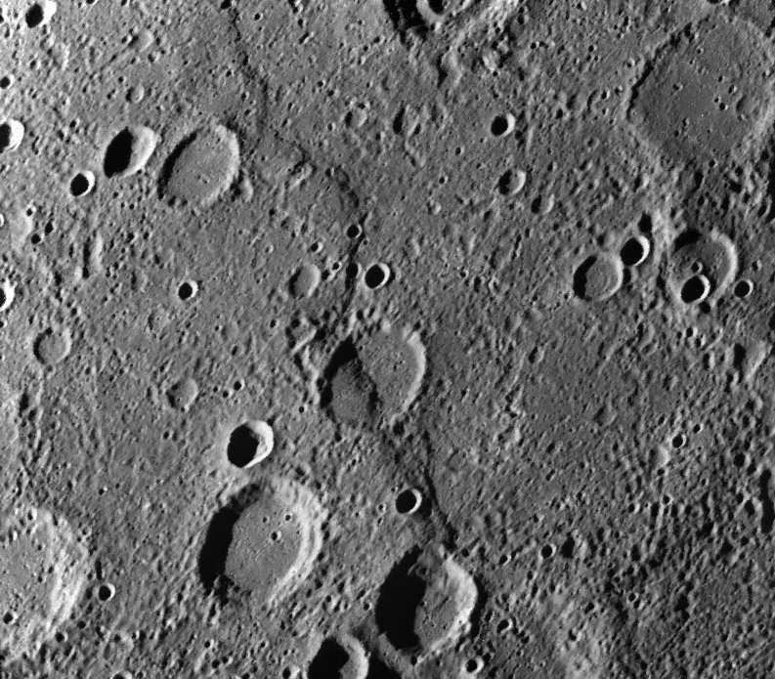
Picture of fault on the planet Mercury.

Slide 46
Picture of fault on the planet Mercury.

Slide 47
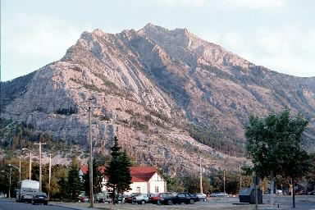

Slide 48
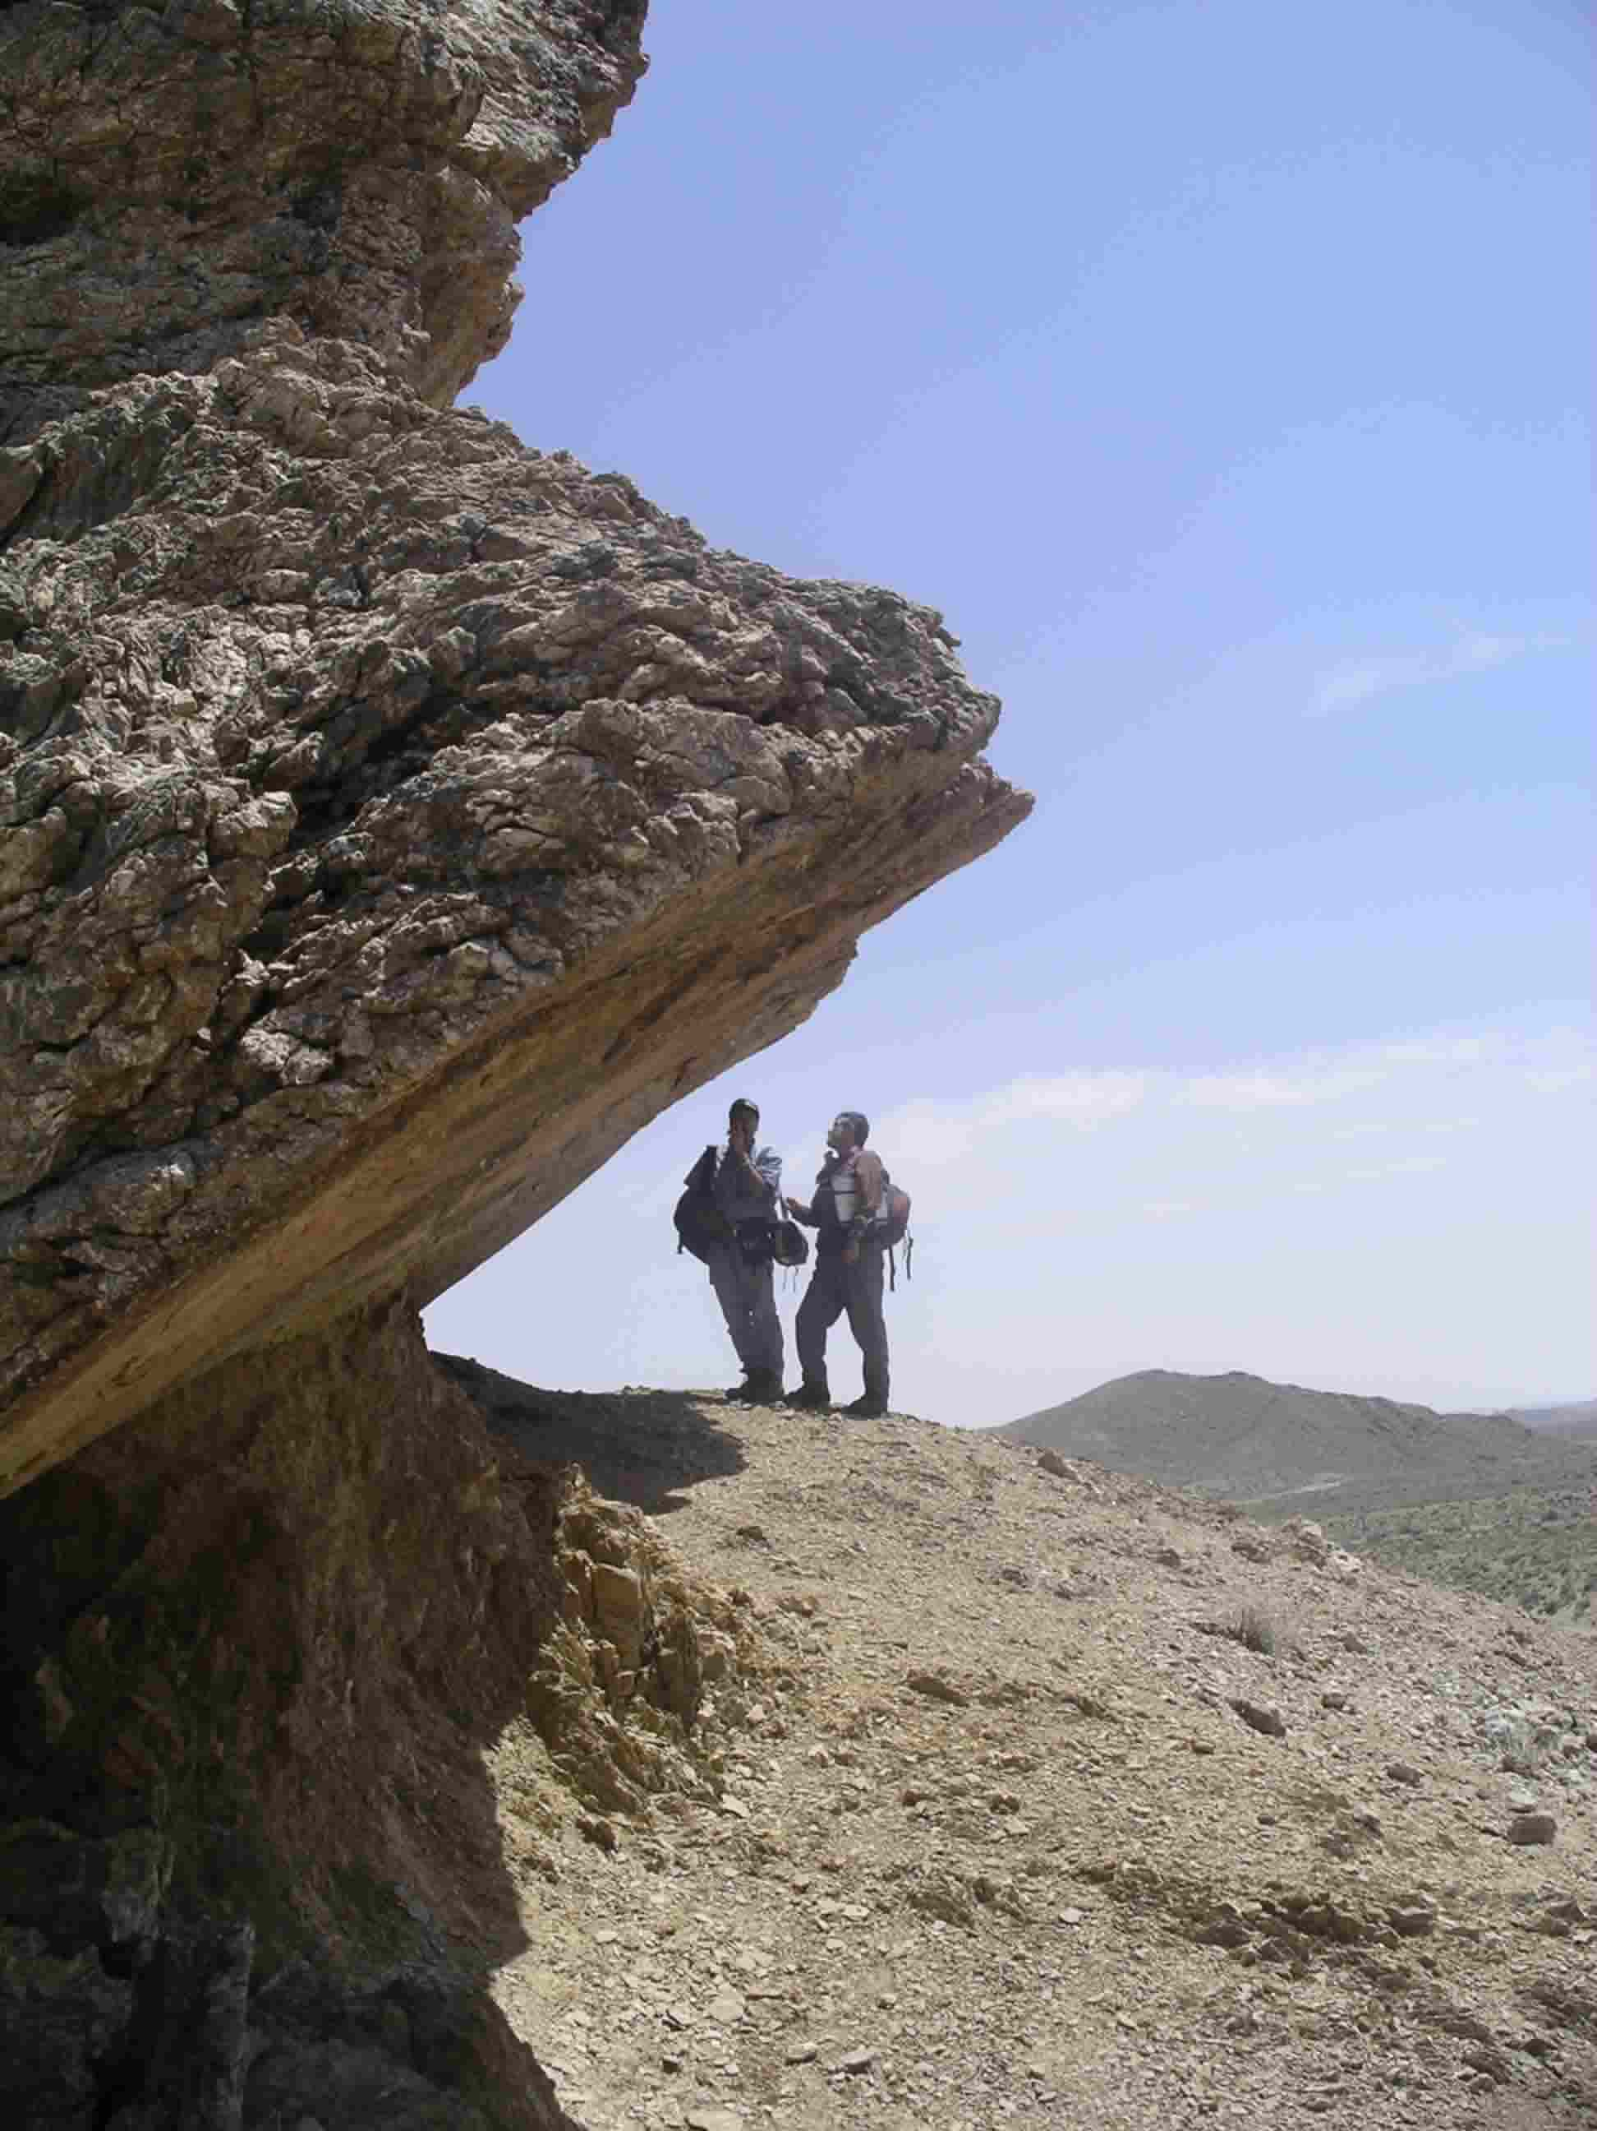

Slide 50
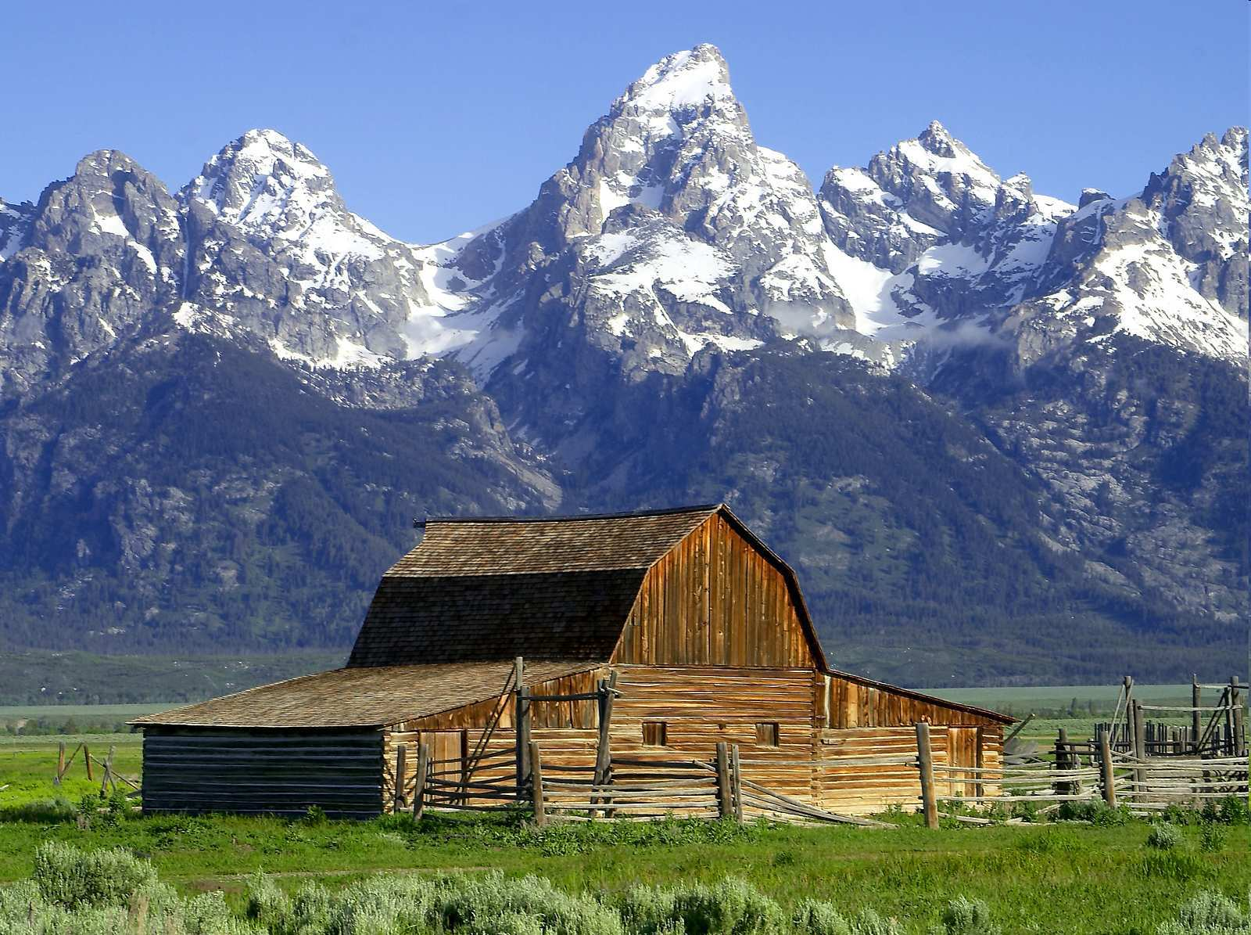

Slide 64
“It’s not my fault.”

Slide 65
Which is a reverse / thrust fault?
A
B
B

Slide 66
Which is a reverse / thrust fault?
A
B
B

Slide 67
Which is a reverse / thrust fault?
A
Normal
B
B

Slide 68
Which is a reverse / thrust fault?
A
Normal
B
B

Slide 69
Which is a reverse / thrust fault?
A
Normal
B
B
Reverse / Thrust

Slide 70
“It’s your fault.”

Slide 71
Which is a normal fault?
A
B

Slide 72
Which is a normal fault?
A
B

Slide 73
Which is a normal fault?
A
B
Reverse / Thrust

Slide 74
Which is a normal fault?
A
B
Normal
Reverse / Thrust

Slide 75
“I fault you.”

Slide 76
Is this a normal fault? (True of False)

Slide 77
Is this a normal fault? (True of False)

Slide 78
Is this a normal fault? (True of False)
False - It's a ______

Slide 79
Is this a normal fault? (True of False)
False - It's a ______
Thrust

Slide 80
“It’s your fault.”

Slide 81
Is this a normal fault? (True of False)

Slide 82
Is this a normal fault? (True of False)

Slide 83
Is this a normal fault? (True of False)
False - It's a ______
Thrust

Slide 84
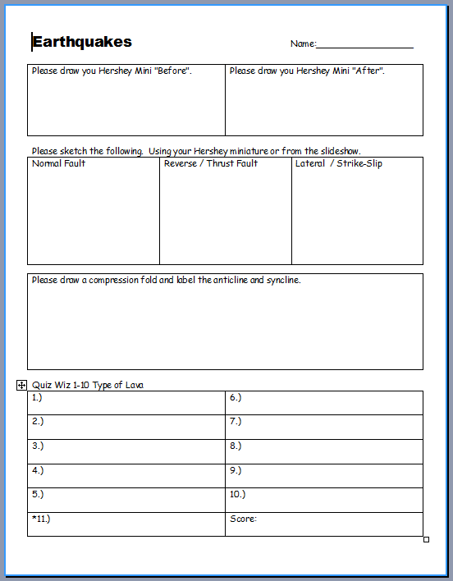

Slide 85
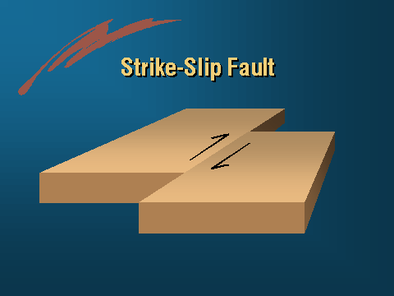
Lateral or Strike Slip Fault: Crust moves alongside each other in opposite directions.
Copyright © 2010 Ryan P. Murphy

Slide 86
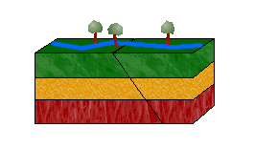

Slide 87
“Fault, Who goes there.”

Slide 88
Which is a lateral fault?
A
B

Slide 89
Which is a lateral fault?
A
B

Slide 90
Which is a lateral fault?
A
Lateral
B

Slide 91
Which is a lateral fault?
A
Lateral
B

Slide 92
Which is a lateral fault?
A
Lateral
B
Reverse / Thrust

Slide 94
“My Fault.”

Slide 95
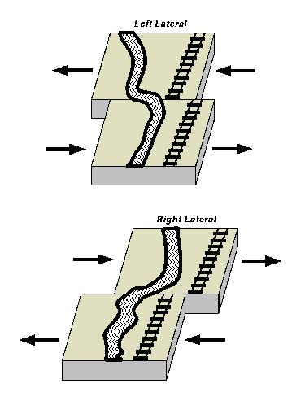
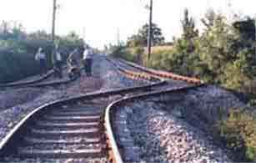

Slide 96
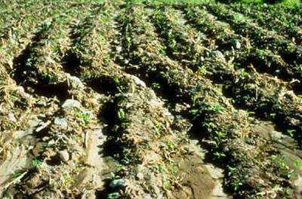

Slide 98
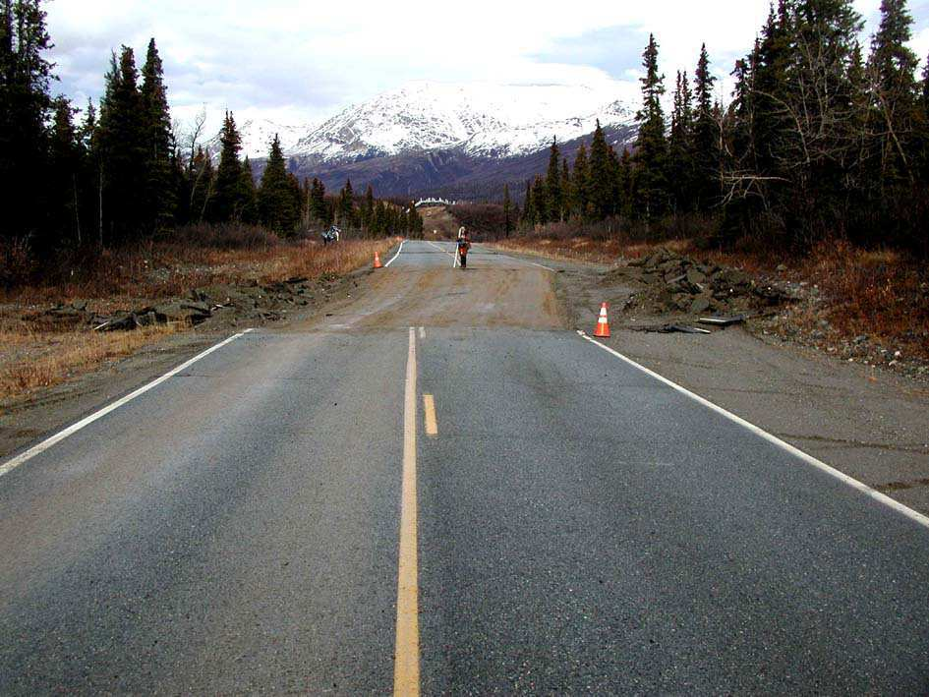

Slide 101
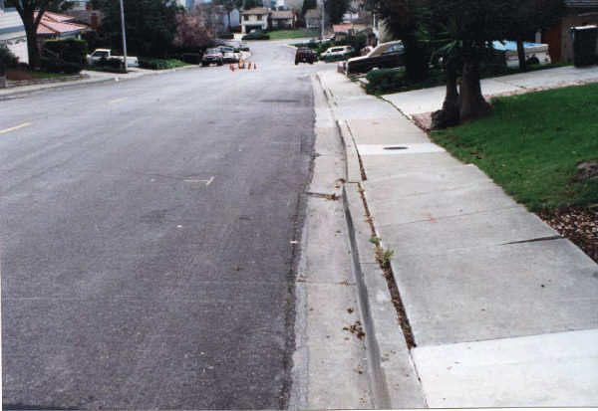

Slide 102
Might want to think
twice about buying
that house

Slide 103
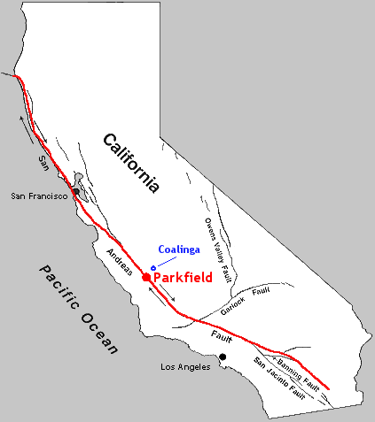
San-Andreas Fault in California.

Slide 104
San-Andreas Fault in California.

Slide 105
San-Andreas Fault in California.

Slide 107
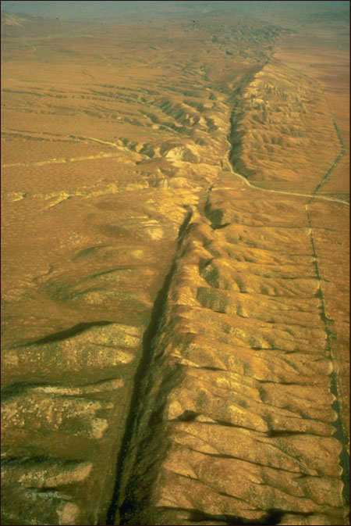
Video! The San Andreas Fault.
http://www.youtube.com/watch?v=ixVVuN-mF1M

Slide 108
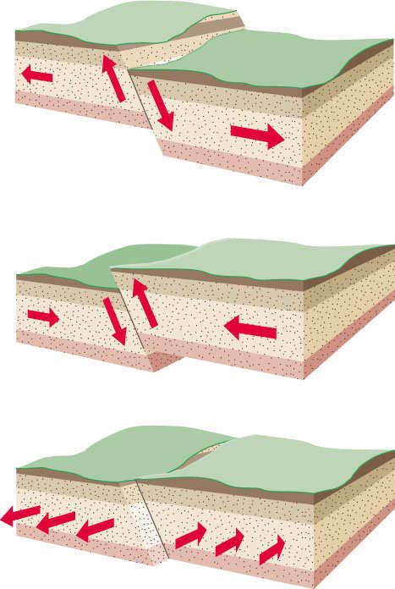
Name the type of fault.

Slide 109
Name the type of fault.

Slide 110
Name the type of fault.
Normal

Slide 111
Name the type of fault.
Normal

Slide 112
Name the type of fault.
Normal
Reverse

Slide 113
Name the type of fault.
Normal
Reverse

Slide 114
Name the type of fault.
Normal
Reverse
Lateral

Slide 115
Activity! Demonstrate the three types of faults you have learned using your Hershey’s Miniature.
Normal Fault
Reverse / Thrust Fault
Strike-Slip / Lateral
Eat after teacher has seen you demonstrate an understanding of these faults
Copyright © 2010 Ryan P. Murphy

Slide 117
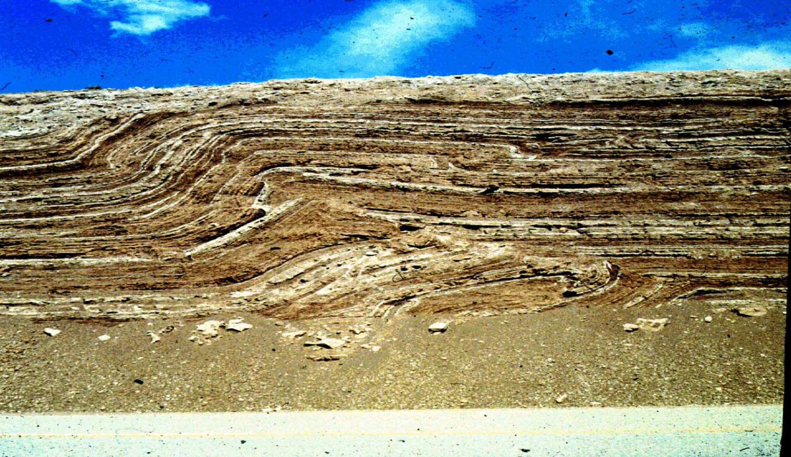
Fold: Collision of crust bends rock layers. “Stress”
Copyright © 2010 Ryan P. Murphy

Slide 118
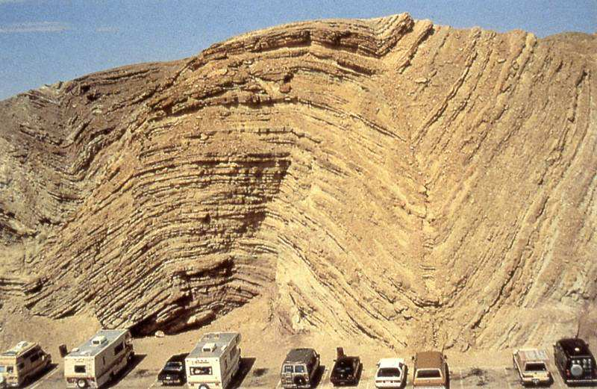

Slide 122
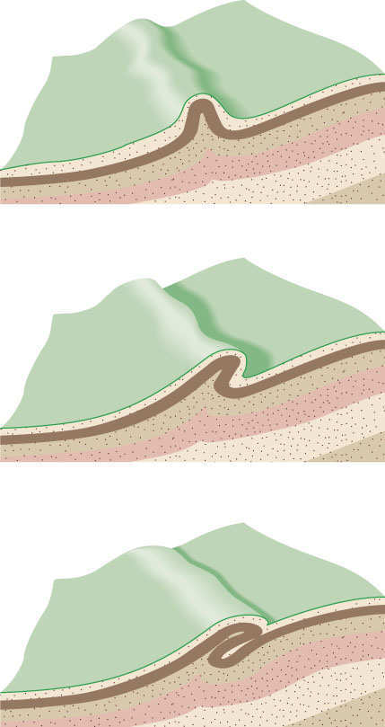

Slide 126
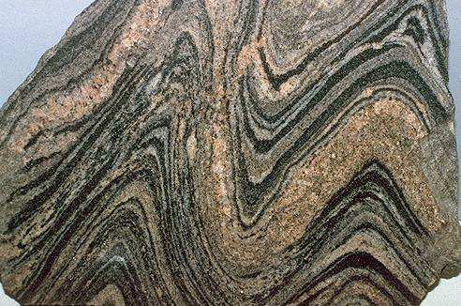
Types of Folds
-
-
-
Copyright © 2010 Ryan P. Murphy

Slide 127
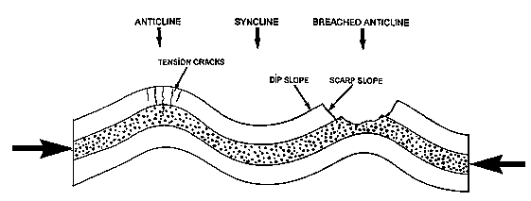
Compression.
-
-
Copyright © 2010 Ryan P. Murphy

Slide 128
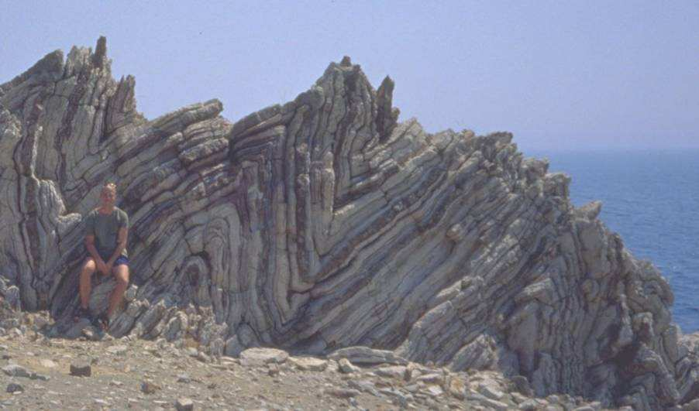
Anticline: ☹
Copyright © 2010 Ryan P. Murphy

Slide 129
Syncline: ☺
Copyright © 2010 Ryan P. Murphy

Slide 130
What type of face should we draw?
Copyright © 2010 Ryan P. Murphy

Slide 131
Answer! Syncline.
Syncline
Copyright © 2010 Ryan P. Murphy

Slide 132
What type of face should we draw?
Copyright © 2010 Ryan P. Murphy

Slide 133
Answer! Anticline.
Anticline
Copyright © 2010 Ryan P. Murphy

Slide 134
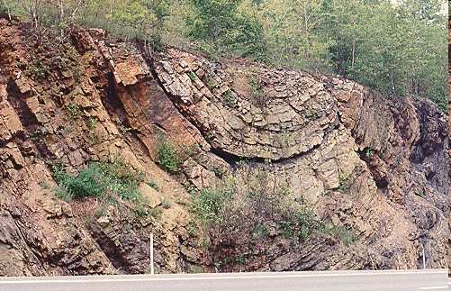
Is this a anticline or syncline?
Copyright © 2010 Ryan P. Murphy

Slide 135
Answer! Syncline.
Copyright © 2010 Ryan P. Murphy

Slide 136
Answer! Syncline.
Copyright © 2010 Ryan P. Murphy

Slide 137
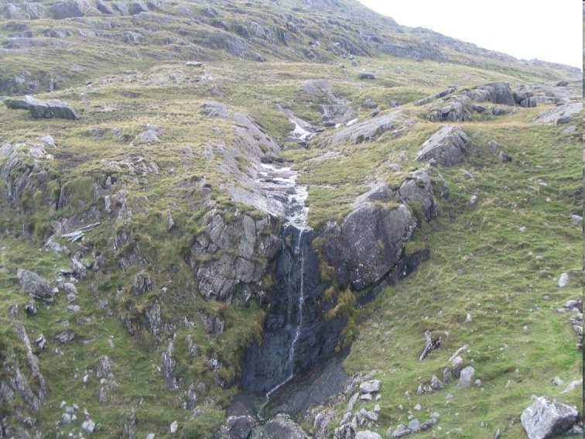
What is this a picture of?
Copyright © 2010 Ryan P. Murphy

Slide 138
Answer! Syncline Fold.
Copyright © 2010 Ryan P. Murphy

Slide 139
Answer! Syncline Fold.
Copyright © 2010 Ryan P. Murphy

Slide 140
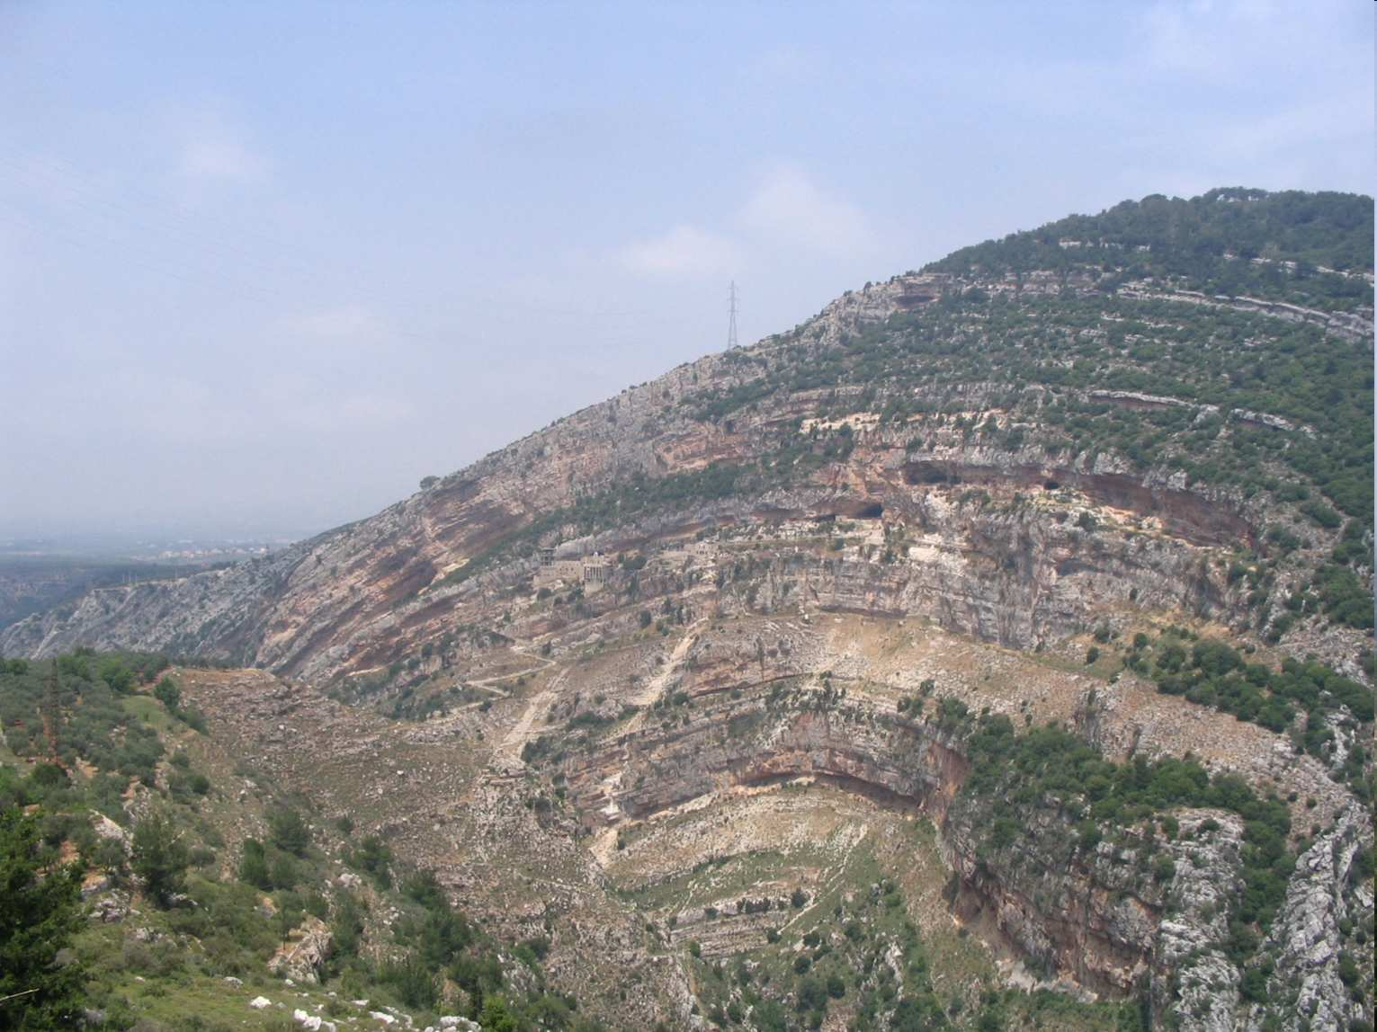
What is this a picture of?
Copyright © 2010 Ryan P. Murphy

Slide 141
Answer! One massive anticline fold.
Copyright © 2010 Ryan P. Murphy

Slide 142
Answer! One massive anticline fold.
Copyright © 2010 Ryan P. Murphy

Slide 143
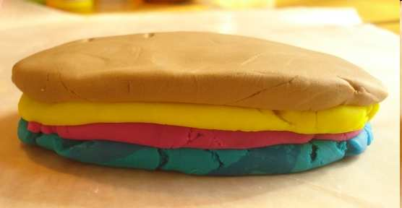
Activity! Making folds.
Flatten out layers of different colored clay and lay them on top of each other.
Compress clay together from either end.
Draw your compression fold in your journal.

Slide 144
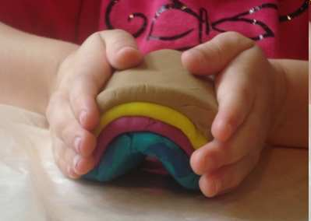
Activity! Making folds.
Flatten out layers of different colored clay and lay them on top of each other.
Compress clay together from either end.
Draw your compression fold in your journal.
Compression Fold
Anticline

